Slide 1
Docker containers
EPG
March 2016

Slide 2
Background

Slide 3
Micro-services
The term "Microservice Architecture" has sprung up over the last few years to describe a particular way of designing software applications as suites of independently deployable services. While there is no precise definition of this architectural style, there are certain common characteristics around organization around business capability, automated deployment, intelligence in the endpoints, and decentralized control of languages and data.
Source: Martin Fowler
What
See definition on the right
How
Decomposing applications into multiple independent services
Leveraging external services
Benefits
Separation of concerns / divede and concquer
Greater reuse opportunities

Slide 4
AMS -> ANV & Controllers
Kafka
Alarm2ES bridge
AMS
ANV
ANV
PM app
JBoss
FluentD
FluentD
OpenTSDB
MariaDB
MariaDB
ES
MariaDB
ES
SDC collector
Process monitor
Kibana
SyslogFluent
Kibana
Rule Calculator
HDFS

Slide 5
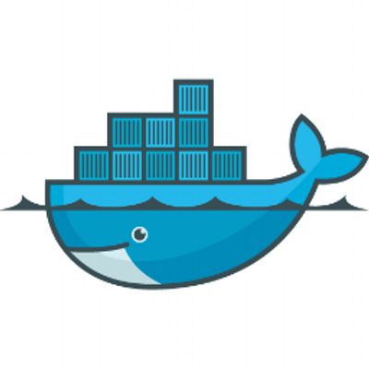
Problem
Having all those services is nice BUT ….
How do you:
Orchestrate it: sizing, network links, deployment across machines
Manage it: how many places to look at logs? monitor data?
Ship it: how many artefacts do you want to download?

Slide 6
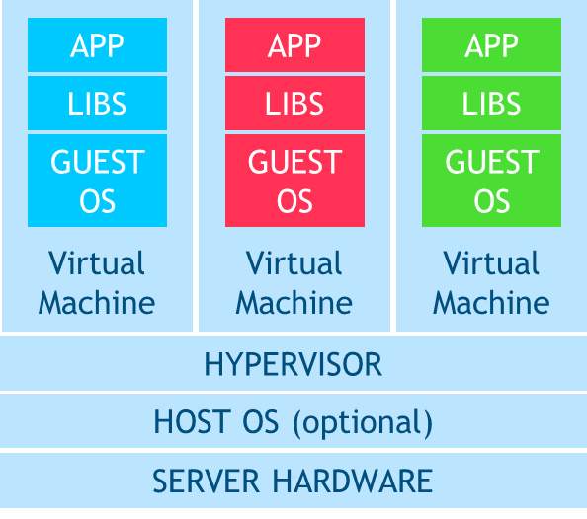
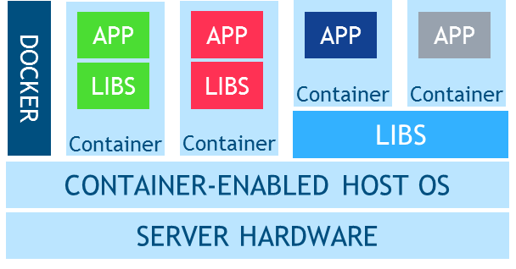
Classical Virtualization & Containers
Classical Virtualization
Virtual Machines
VM technology is mature and well-understood
Better isolation of applications, but larger footprint, and slower boot times
Offers OS flexibility, suitable for applications that run specialized OS types
Adapting legacy applications to VMs is easy but not necessarily desirable
Robust management and security
Containers
Lightweight containers are self-contained and easily portable
Enables encapsulation of reusable parts of applications as microservices
Especially suitable when the need to run legacy or special OS is minimal
Smaller images offers deployment agility in a dynamic environment
Containers do not have the same security isolation available with VMs
Security, management, and orchestration tools are rapidly maturing
Lightweight Containers
Note: most folks would run the docker engine in a VM!

Slide 7
Docker by example

Slide 8
Simple example
Try this
Goal: Run Tomcat in a container
Key operations:
Define Docker file & build it
Run it (docker run -p 8585:8080 becd)
Expose ports, map ports
Exec into container
Copy into container
Map volumes
See logs

Slide 9
Docker file system

Slide 10
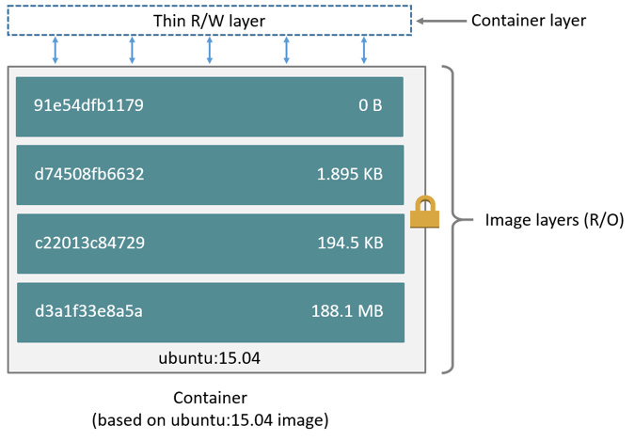
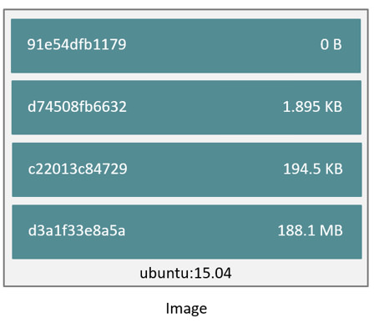
File system

Slide 11
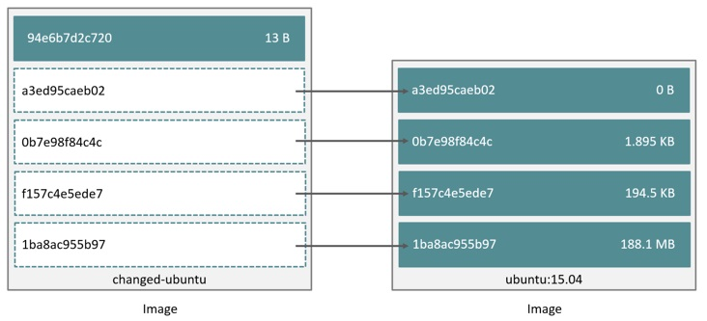
Copy on write

Slide 12
Docker networking

Slide 13
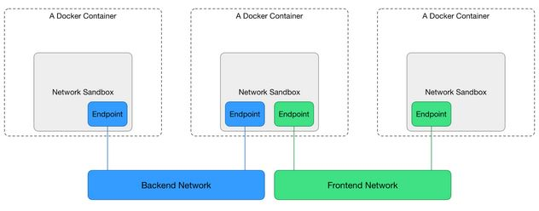
Container networking model
Sandbox
An endpoint
A network
+ container name lookup

Slide 14
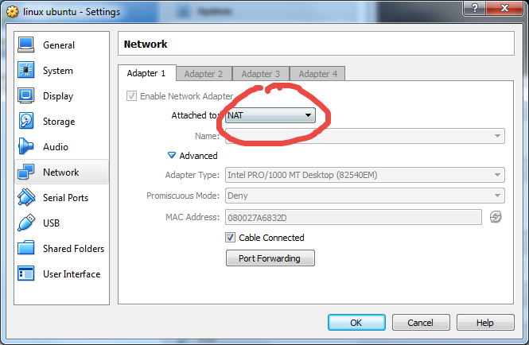
Network types
Bridge
Host
Your own network
Similar options exist in Virtualbox

Slide 15
Docker hub

Slide 16
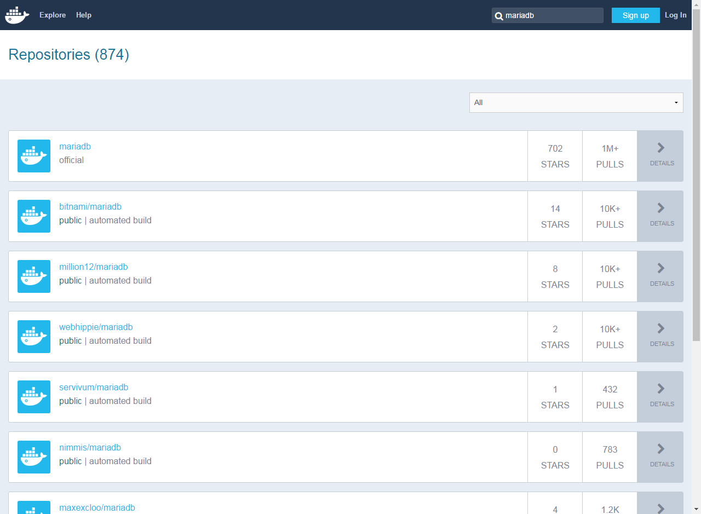
Registry
Public hub
Running your own:
Docker registry
Artifactory
If you understand maven you’ll understand this easily

Slide 17
Artifactory
Where: https://135.249.45.113:9000/artifactory/
docker login 135.249.45.113:9000
docker tag

Slide 18
Compose

Slide 19
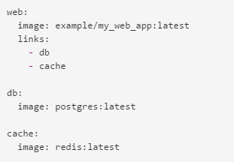
Docker-compose
What: tool for defining and running multiple container solutions
Example:
Links to other containers, available as DNS names

Slide 20
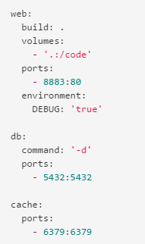
Other examples:
volumes
environment settings
port mapping

Slide 21
ANV example
Live example
Sample files in anv/deployment/compose

Slide 22
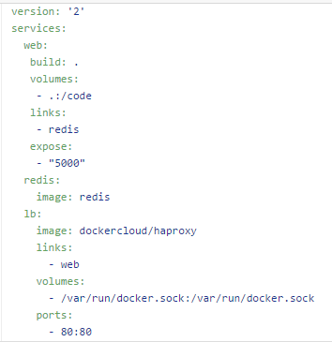
Going beyond docker commands
Scale
See https://www.brianchristner.io/how-to-scale-a-docker-container-with-docker-compose/.

Slide 23
Swarm

Slide 24
Swarm
Creation of a single big Docker Engine spread across multiple physical hosts
Overlay networking, preserves local capabilities
Set constraints in compose files
Different spread strategies supported
Engine
Engine
Engine
Swarm engine

Slide 25
Best practices

Slide 26
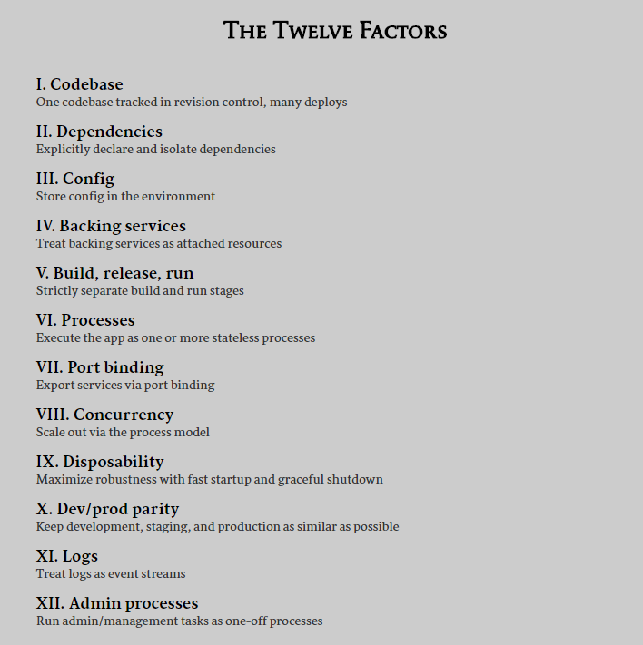

Slide 27
Logging
The general principles
Containers should consider logs as events
So don’t bother about log files, log retention, file rotation etc..
Stream all logs to a centralized place
Provide a frontend to visualize the log files and provide insight
Take it one step further and automatically act on certain log patterns
Technology choices
ELK stack
Fluent as a log shipper / mediator

Slide 28
Log flow
Container
Log driver
Kibana container
Container
Log driver
Container
Log driver
FluentD container
ES container
Watcher
FluentD container with Syslog input
Node
Nokia cloud

Slide 29
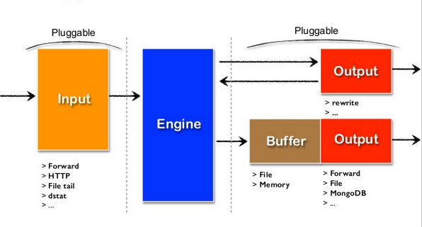
Fluent architecture

Slide 30
Availability

Slide 31
Availability
Container policies: restart behavior
Using containers to load balance entities:
Kubernetes: POD abstraction, Docker catching up
Make the applications fault tolerant. E.g. how do they behave when a piece of the solution

Slide 32
VM-ware
Proposing very lightweight VM’s with a docker engine
So one container = 1 VM
Pitched advantage:
You get all the VM level features now at container level
DRS, HA, …

Slide 33
Dev-ops pipeline

Slide 34
Dev-ops
Situation today
Solution
Commit
UT / sonar
Upload to repo
Demo server
E2E
auto
Manual or pseudo auto
weeks

Slide 35
Dev-ops
Desired scheme
Commit
UT / sonar
E2E
Solution
Upload to repo
Upload to repo
Demo server
Fully auto
< 1 hour
< 1d hour

Slide 36
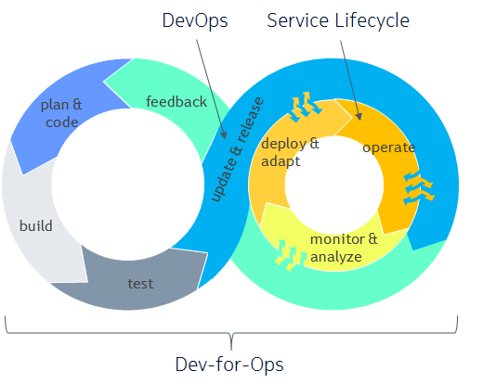
Dev-for-Ops: Developing for Operational Agility
Bring Cloud Agility (from DevOps) to CSP networks
Development of services that bind together applications with automated deployment and life cycle management
In service software upgrade (continuous integration, delivery and deployment)
Reduce error probability, system anomaly detection via behavioral models, defect prediction
Allow user insight to tune solution (per operator) with trusted feedback mechanism
Allows continuous integration and delivery of VNFs into customer networks
Notes:
The first 3 items in key disruptions are covered by research project in Bell Labs the last one is supported by the new functionality in Dev-for-Ops

Slide 37
Big picture plan

Slide 38
Virtualization of Network Functions
Further decomposition improves flexibility and ability to efficiently present outputs as reusable processes
Virtualization != Cloud Virtualization < Cloud
Programmable Stack
API
API
API
API
OPEX Savings & Efficiency through Automation, Standardization and Scale
APP
APP
APP
Cloud Stack
CAPEX Savings Through Server Consolidation
APP
APP
APP
Cloud Layer
Cloud Layer
API
API
API
API
Operations
Operations
Virtualization Stack
APP
APP
APP
Infrastructure Services
Traditional Stack
Infrastructure Services
APP
APP
APP
Virtualization Layer
Virtualization Layer
Virtualization Layer
HW
HW
HW
Virtualization
Automation
Programmable
Telco Cloud
HW
HW
HW
HW
HW
HW
HW
HW
HW
Evolution to true cloud enablement is a multi-stage process
Notes:
APP = Applications
API = Application Programming Interface
HW = Hardware (including computing power, storage, networking and facilities)

Slide 39
Key Principles for Network Function Virtualization
App
App
App data
App
App
App
Separate data from application logic
Quickly and seamlessly add vNF capacity
Can lead to Shared Data Layer used by all applications
Decompose functionality
Deploy independent vNF functionality
Each function has scalability characteristics
Use commoditized cloud functions
Cloud functions providing common resources
Use of these services depends on vNF SLAs
Adhering to key architectural principles ensures VNFs fully benefit from the cloud in the end state

Slide 40


